Slide 1
NOD2 and Crohn’s Disease
Jonathan Peterson

Slide 2
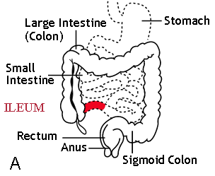
What is Crohn’s Disease(CD)?
Intestinal inflammation
Immune dysfunction
Symptoms
Malnutrition
Dehydration
Diarrhea
Intestinal blockage
http://upload.wikimedia.org/wikipedia/en/b/bd/Patterns_of_CD.jpg

Slide 3
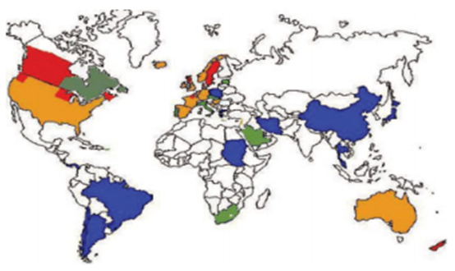
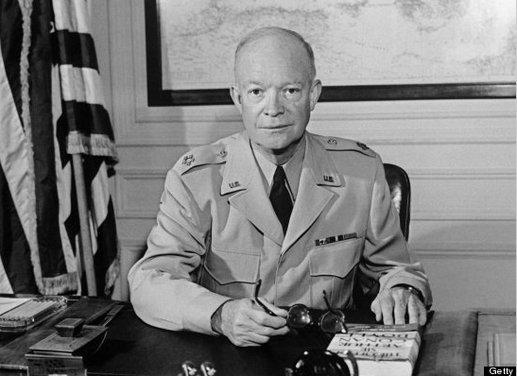
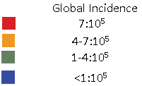
Who is at risk?
European Descent
Industrialized areas
http://www.huffingtonpost.com/2011/08/01/celebs-crohns_n_913641.html#s318538&title=Dwight_D_Eisenhower
http://www.mayoclinic.com/health/crohns-disease/ds00104/dsection=risk-factors

Slide 4
What causes CD?
Environmental factors
microbiome
“let them eat dirt”
Genetics
MZ Twin studies
56% genetic
Complex Disease
71 variants=30% of heritability
3 strongest in NOD2
http://www.harpyness.com/2011/02/04/om-nom-nom-moar-bugs/
http://mbe.oxfordjournals.org/content/early/2012/03/05/molbev.mss006.full.pdf+html)
Notes:
Everything is so damn sanitized we don’t get to build up our normal gut flora and immune response.
10* more Bact cells, forgotten organ
56% concordance

Slide 5
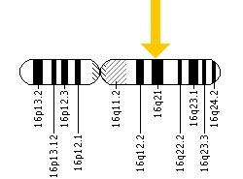
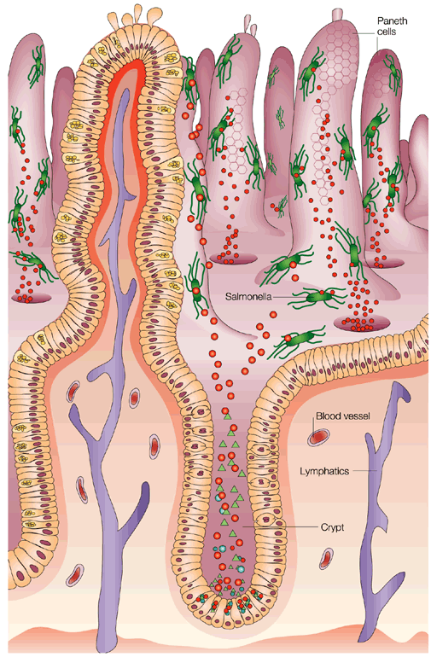
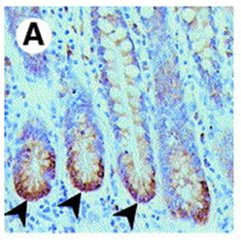
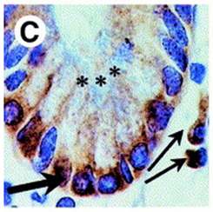
But what is NOD2?
Nucleotide-binding oligomerization domain-containing protein 2
Intestinal macrophages and epithelial cells
Immune response
http://ghr.nlm.nih.gov/gene/NOD2
http://www.sciencedirect.com/science/article/pii/S0016508503006619
http://www.nature.com/nri/journal/v3/n9/fig_tab/nri1180_F5.html
Notes:
Long arm of chromosome 1
A,C=NOD2 rnai riboprobe assay Brown= NOD2 expression

Slide 6
NOD2 Domains
2 CARD domains
1 NACHT(NOD) domain
Leucine Rich repeats
http://smart.embl-heidelberg.de/smart/show_motifs.pl
Notes:
C-terminal LRR recognizes MDP from gram + gram – cell wall
NACHT is involved in oligomerization upon ligand binding, resulting in ability to initiate rip2/RICK
NOD= nucleotide-binding oligo domain
CARD domains interact with rip2 (RICK) to eventually initiate NFkB transcription factor activity

Slide 7
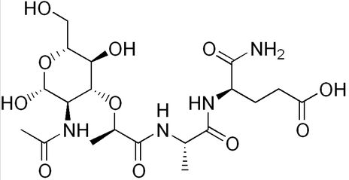
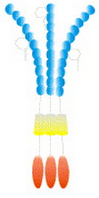
MDP induced oligomerization
LRR Domain
NACHT Domain
Inactive
Active
http://www.sciencedirect.com/science/article/pii/S1286457904000796
http://jmol.sourceforge.net/
Notes:
N-terminal Leucine Rich Repeat binds MDP
NACHT domain facilitates oligomerization.

Slide 8
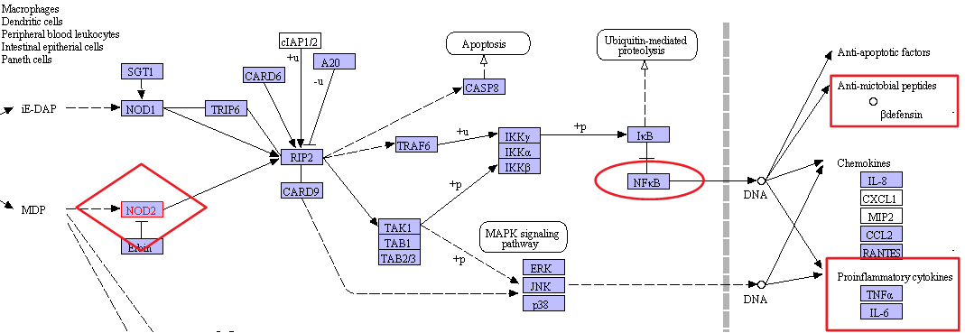
Bacteria Alarm System
http://www.kegg.jp/kegg-bin/show_pathway?ko04621+K10165
http://www.idownloadblog.com/2012/01/02/is-your-iphone-alarm-clock-not-working-heres-how-to-fix-it/
Notes:
Initiates pathway resulting in defensins (antibiotics), and Cytokines, which cause immune response and inflammation.

Slide 9
NOD2 and CD
3 NOD2 variants
SNP8(702 R➔W)
SNP12 (908 G➔R)
SNP13 (1007 fs)
SNP8
SNP13
SNP12
http://smart.embl-heidelberg.de/smart/show_motifs.pl
Notes:
All 3 most comon variants are at the LRR (MDP) interacting region

Slide 10
What goes wrong?
Faulty MDP recognition leads to altered immune response
MDP
NOD2
RIP2-kinase
NFkB
Immune response
http://www.sciencedirect.com/science/article/pii/S1286457904000796
http://www.google.com/imgres?hl=en&sa=X&
http://jmol.sourceforge.net/
Notes:
N-terminal Leucine Rich Repeat binds MDP
NACHT domain facilitates oligomerization.

Slide 11
Why Inflammation?
Contradiction?
Main theories
Faulty alarm
NOD2 negative NFkB feedback
Still lots of Debate
http://40-somethinglife.blogspot.com/2012/04/life-my-love-for-snooze-button.html

Slide 12
Why add to the controversy?
Address the problem at NOD2 instead
Current treatments act downstream of NFkB
IDEA: Look for targets upstream
Directly affect NOD2

Slide 13
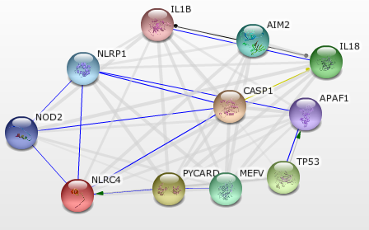
String Analysis
http://string.embl.de
Notes:
Centered on NLRP1 because it looks better

Slide 14
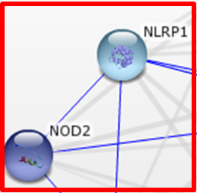
NLRP1(aka NALP1)
NLRP1 Interacts with MDP AND NOD2!!!

Slide 15
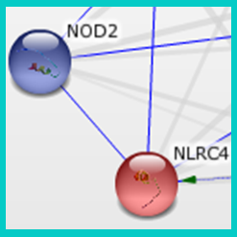
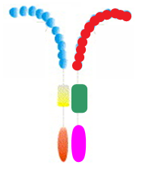
NLRC4(aka CLAN)
NOD2-CLAN and NLRP1-Clan hetero-oligomers!!!
http://string.embl.de
Notes:
Paper by Damiano et al

Slide 16
Common Domains
NLRP1
NOD2
CLAN
http://smart.embl.de
http://string.embl.de
Notes:
NACHT common in all hetero-oligo forming compounds
LRR in those that

Slide 17
Main Hypothesis
NOD2 oligomerizes with several proteins in MDP dependent fashion, resulting in diverse immune response
Altered Immune Response
http://www.sciencedirect.com/science/article/pii/S1286457904000796
http://jmol.sourceforge.net/
Notes:
N-terminal Leucine Rich Repeat binds MDP
NACHT domain facilitates oligomerization.

Slide 18
Experiment
Identify potential NOD2 oligomerization partners using BLAST analysis
Construct model system
Use TAP/MS in presence and absence of MDP to test for interactions.
Microarray for expression of interacting proteins
Notes:
2 use cell culture expressing TAP-tagged NOD2, in presence and absence of NOD2 and do mass spec

Slide 19
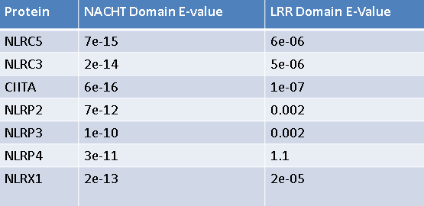
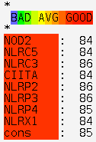
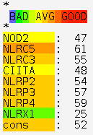
1. Potential NOD2 partners
Blast Analysis
T-Coffee Alignment
NACHT Domain
LRR Domain
http://tcoffee.crg.cat//
Notes:
Blasted both for LRR as well
NACHT domain well conserved so hope good hope for hetero-oligomers. LRR not very well conserved but we know NLRP1 responds to MDP so not too worried. More variation in LRR spacing etc.
T-coffee, NACHT oligomerization more important than LRR binding MDP

Slide 20
Proteins identified via BLAST
NOD2
NLRC5
NLRC3
CIITA
NLRP2
NLRP3
NLRP4
NLRX1
http://smart.embl.de
Notes:
Talk about function here
NLRC=NOD-like receptor family CARD domain containing #
NLRP= NACHT, LRR, PYD(Pyrin)
NLRX1=NOD

Slide 21
Experiment
Identify potential NOD2 oligomerization partners using BLAST analysis
Construct model system
Use TAP/MS in presence and absence of MDP to test for interactions.
Analyze CD Microarray for expression of interacting proteins
Notes:
2 use cell culture expressing TAP-tagged NOD2, in presence and absence of NOD2 and do mass spec

Slide 22
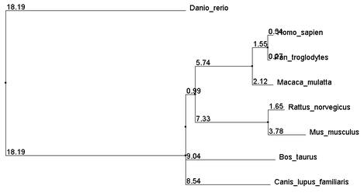
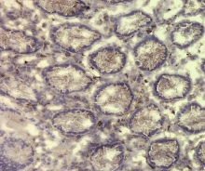
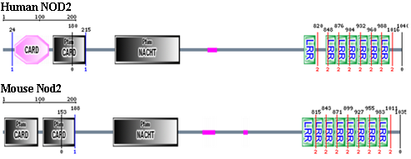
Model organism?
http://ajpgi.physiology.org/content/292/3/G829.full.pdf+html
Notes:
Why not human

Slide 23
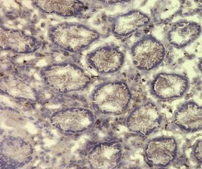
NCM460 cell line Model
IT’S MADE OF PEOPLE!
Epithelial colon cells
Transfect with TAP-NOD2
½ in MDP ½ in Saline
TAP
http://ajpgi.physiology.org/content/292/3/G829.full.pdf+html
Notes:
Soylent green.
Transfect with plasmid/vector N-terminus

Slide 24
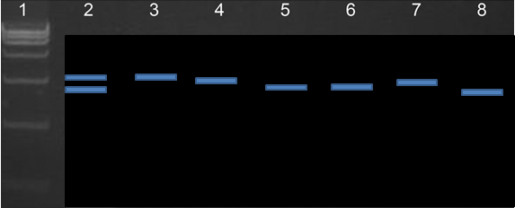
Check expression
Lyse transfected cells and run PCR
Confirm transfection and normal expression
 | mRNA
2 | NOD2
3 | NLRC5
4 | NLRC3
5 | CIITA
6 | NLRP2
7 | NLRP3
8 | NLRP4
TAP-NOD2
Notes:
Straight forward

Slide 25
Experiment
Identify potential NOD2 oligomerization partners using BLAST analysis
Construct model system
Use TAP/MS in presence and absence of MDP to test for interactions.
Analyze CD Microarray for expression of interacting proteins
Notes:
2 use cell culture expressing TAP-tagged NOD2, in presence and absence of NOD2 and do mass spec

Slide 26
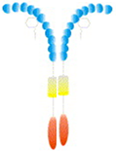
TAP/MS Results
Type 1:
Type 2:
Type 3:
RIP2
Notes:
Type 1, normal, boring binding
Type 4 would be multiple proteins interacting at NACHT portion
X could be anything
Type 2 nod independent
Type 3 most interesting for us

Slide 27
CD Biopsy Microarray: Expression downstream of
“X”
Type 1 Type2 Type3
Region of interest
Region of interest
http://www.jbc.org/content/281/4/2380.full

Slide 28
Future Directions
Identify affected “X” genes and their pathways
More Microarray investigation
More TAP
GWAS
Microbiome research
Fecal transplant

Slide 29
Questions?

Slide 30
References
"CCFA.org: About Crohn's Disease." CCFA.org: Home. Web. <http://www.ccfa.org/info/about/crohns>.
Chiodini, RJ. "Crohn's Disease and the Mycobacterioses: A Review and Comparison of Two Disease Entitie." Ameican Society for Microbiology 2 (1989): 90-117. Print.
"Crohn's Disease - Causes, Symptoms & Treatment." EMedicineHealth.com. Web. http://www.emedicinehealth.com/crohn_disease/article_em.htm
"Crohn's Disease Symptoms." Tree. Web. http://www.tree.com/health/crohns-disease-symptoms.aspx
Staff, Mayo Clinic. "Crohn's Disease: Causes - MayoClinic.com." Mayo Clinic. Web. <http://www.mayoclinic.com/health/crohns-disease/DS00104/DSECTION=causes>.
Vignal, Cecile, Elisabeth Singer, Laurent Peyrin-Biroulet, Pierre Desreumaux, and Mathias Chamaillard. "How NOD2 Mutations Predispose to Crohn's Disease?" Microbes and Infection 9.5 (2007): 658-63. Print.
Yazdanyar, Shiva, Maren Weischer, and Borge G. Nordestgaard. "Genotyping for NOD2 Genetic Variants and Crohn Disease: A Metaanalysis." Clinical Chemistry 55.11 (2009): 1950-957. Print.

Slide 31
